Slide 1
By
K PAVAN KUMAR
Dept. Of CSE
VFSTR University

Slide 2
Canonical LR ( 1 )
Canonical lookahead Parser
LR (1) items to build
Produces the more number of states as compare to the SLR (1) parsing.
Place the reduce node only in the lookahead symbols.

Slide 3
Steps are
Add augment production in the given grammar
Create canonical collection of LR (1) items
(LR(1)=LR (0) item + look ahead)
Construct a CLR (1) parsing table

Slide 4
Construct the CLR(1) parse table for S→AA; A→aA | b.
Given
S→AA ➔R₁
A→aA ➔R₂
A→b ➔R₃
Step1: Augmented Grammar
S’→S
S→AA
A→aA
A→b

Slide 5
Step2: LR(1) Items
Always begin with augmented grammar production with $
S’→.S,$
To close match the item with A→α.xβ,a
Where α = ϵ, x = S, β=ϵ, a=$
If there is a production x→ﻹ,b then add x→. ﻹ,b
Here X=S
S→.AA ,b
b=First(βa)=First(ϵ$)=First($)={$}
i.e S→.AA ,$
Match the item with A→α.xβ,a
Where α = ϵ, x = A, β=A, a=$
If there is a production x→ﻹ,b then add x→. ﻹ,b

Slide 6
Here X=A
A→.aA,b
b=First(A$)=First(A)={a,b}
i.e A→.aA, a | b
A→.b, b
b=First(A$)=First(A)={a,b}
i.e A→.b, a | b
If the next symbol of “.”(dot) is terminal then no need of compare.

Slide 7
Finally the productions are
S’→S,$
S→AA ,$
A→aA, a | b
A→b, a | b

Slide 8
Step2: LR(1) Items

Slide 9
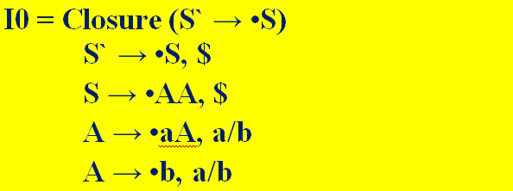
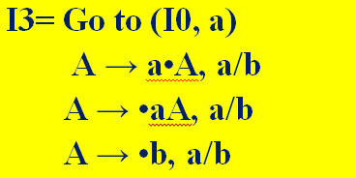
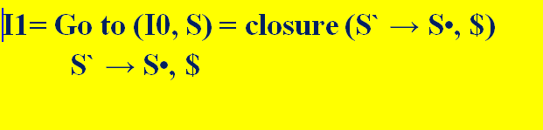
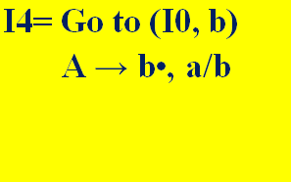
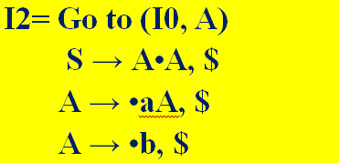

Slide 10

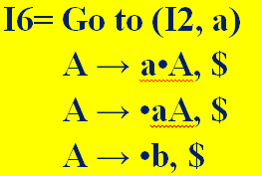
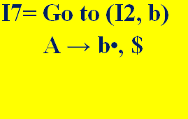

Slide 11

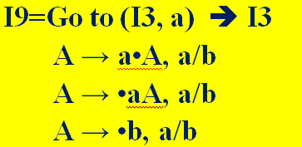
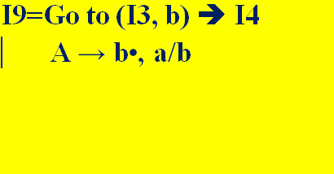

Slide 12
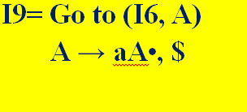
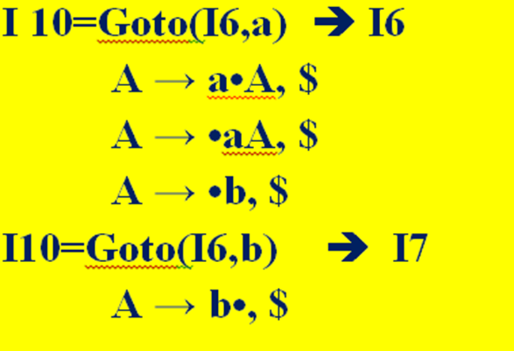

Slide 13
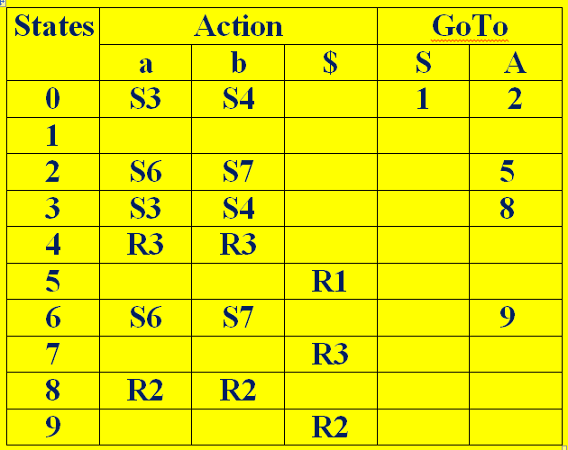
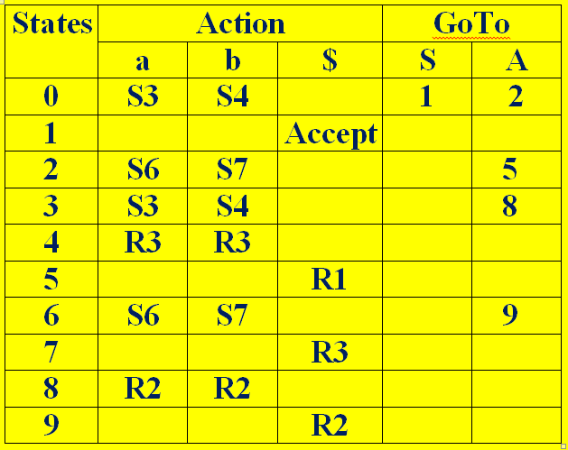
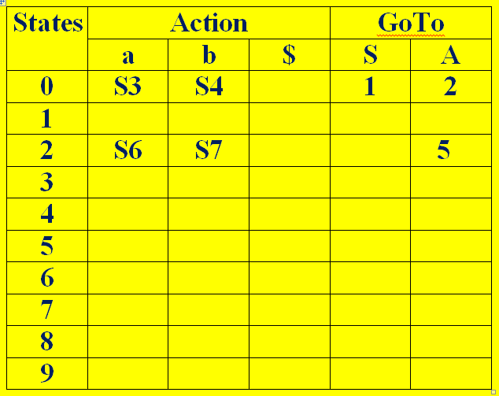
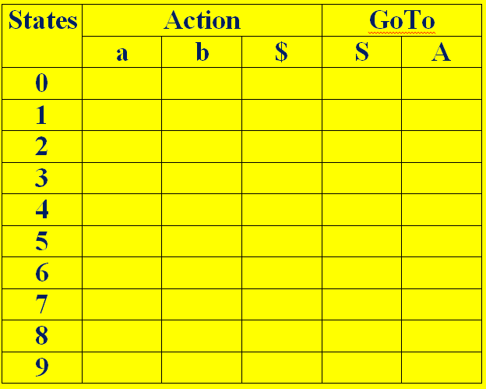
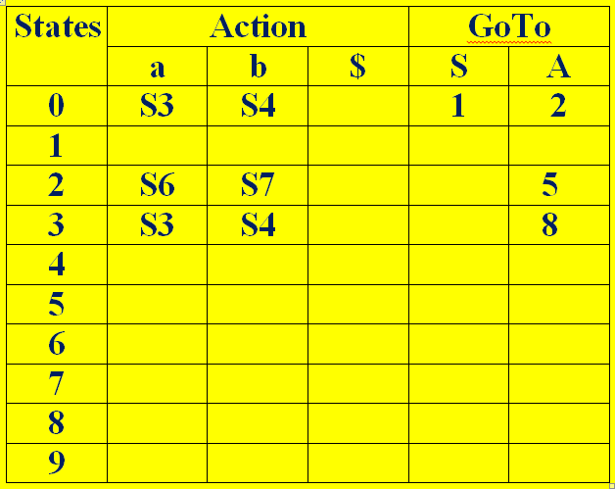
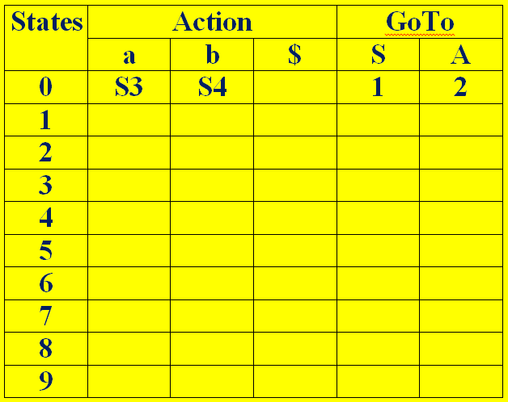
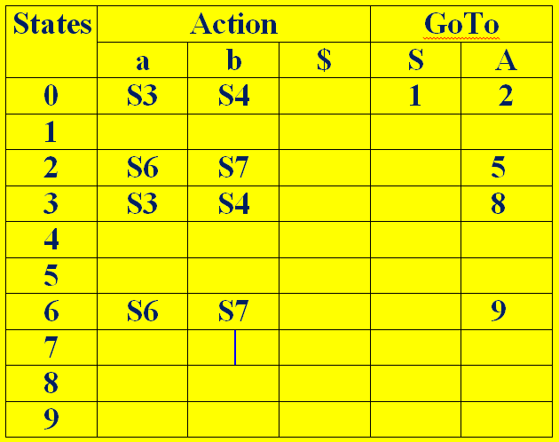
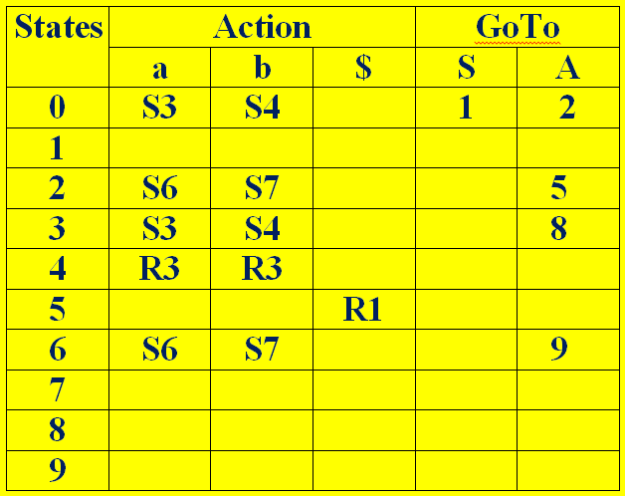
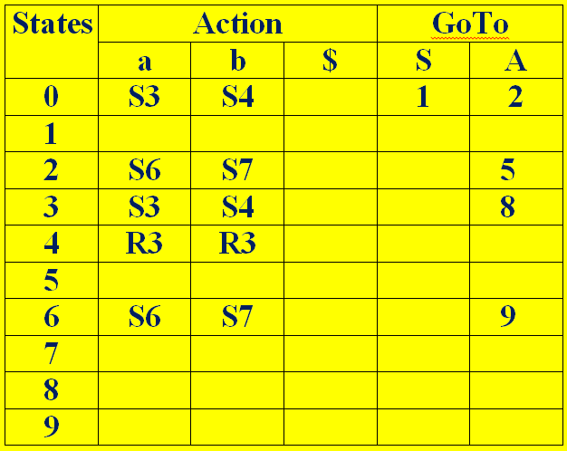
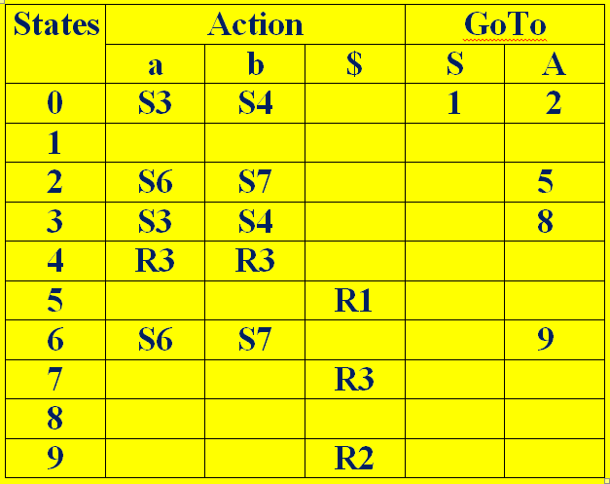


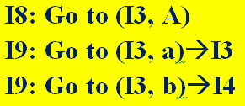

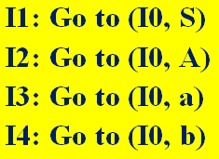

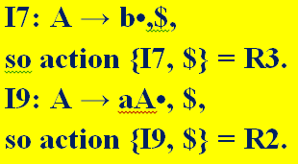
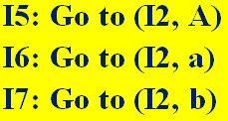
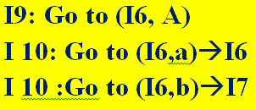


Step3: Construct a CLR (1) parsing table

Slide 14
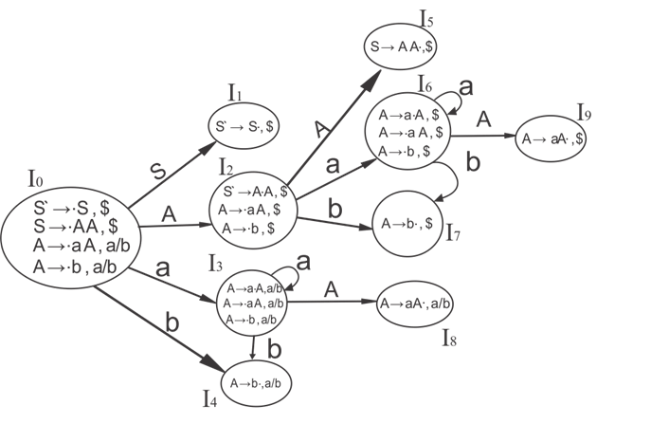
DFA

Slide 15
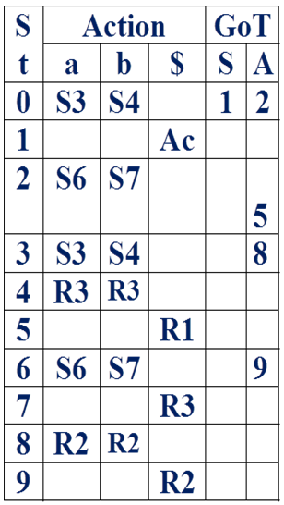
Stack Implementation for Input string “abb”
Stack I.Buffer Action
$0 abb$ Shift
$0a3 bb$ Shift
$0a3b4 b$ A→b
$0a3A8 b$ A→aA
$0A2 b$ Shift $0A2b7 $ A→b
$0A2A5 $ S→AA
$0S1 $ Accept

Slide 16
LALR (1) Parsing

Slide 17
LALR(1)
LALR refers to the Look Ahead LR.
LR (1) items required to construct.
In the LALR (1) parsing, the LR (1) items which have same productions but different look ahead are combined to form a single set of items.
LALR (1) parsing is same as the CLR (1) parsing, only difference in the parsing table.

Slide 18
Steps are
Add augment production in the given grammar
Create canonical collection of LR (1) items
(LR(1)=LR (0) item + look ahead)
LR (1) items should be combine.
Construct a LALR (1) parsing table

Slide 19
Construct the LALR(1) parse table for S→AA; A→aA | b.
Given
S→AA ➔R₁
A→aA ➔R₂
A→b ➔R₃
Step1: Augmented Grammar
S’→S
S→AA
A→aA
A→b

Slide 20
Step2: LR(1) Items
Always begin with augmented grammar production with $
S’→.S,$
To close match the item with A→α.xβ,a
Where α = ϵ, x = S, β=ϵ, a=$
If there is a production x→ﻹ,b then add x→. ﻹ,b
Here X=S
S→.AA ,b
b=First(βa)=First(ϵ$)=First($)={$}
i.e S→.AA ,$
Match the item with A→α.xβ,a
Where α = ϵ, x = A, β=A, a=$
If there is a production x→ﻹ,b then add x→. ﻹ,b

Slide 21
Here X=A
A→.aA,b
b=First(A$)=First(A)={a,b}
i.e A→.aA, a | b
A→.b, b
b=First(A$)=First(A)={a,b}
i.e A→.b, a | b
If the next symbol of “.”(dot) is terminal then no need of compare.

Slide 22
Finally the productions are
S’→S,$
S→AA ,$
A→aA, a | b
A→b, a | b

Slide 23
STEP2: LR(1) Items

Slide 28
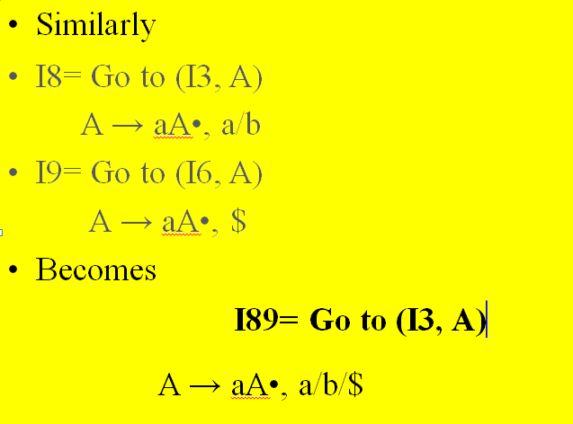
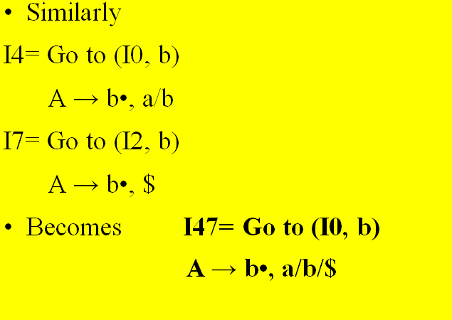
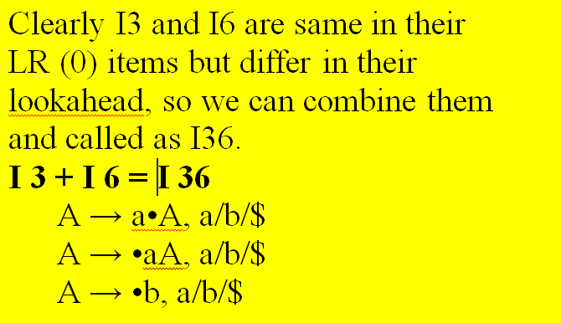
If we analyze then LR (0) items of I3 and I6 are same but they differ only in their lookahead.

Slide 29
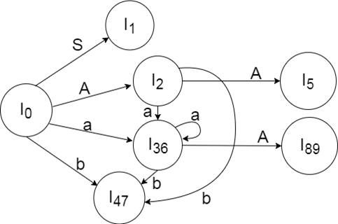
DFA

Slide 30
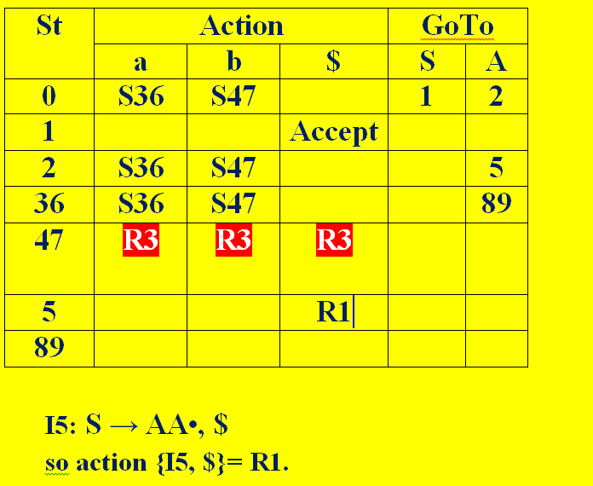
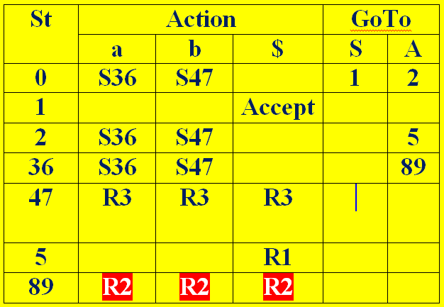
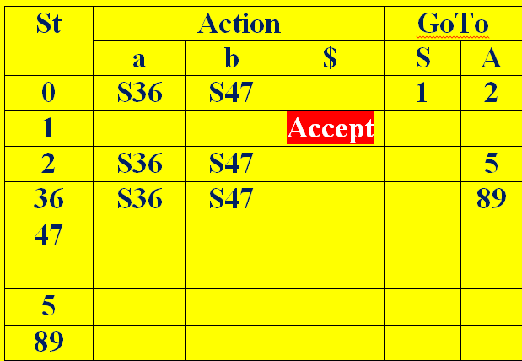
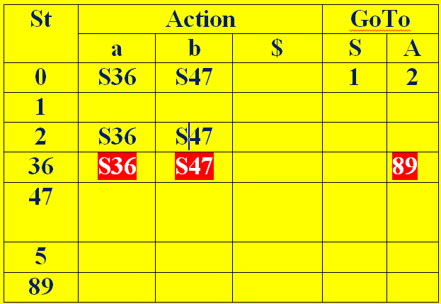
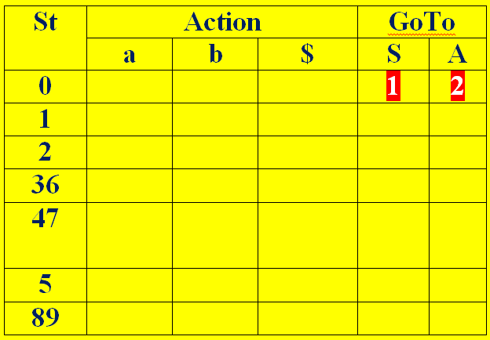
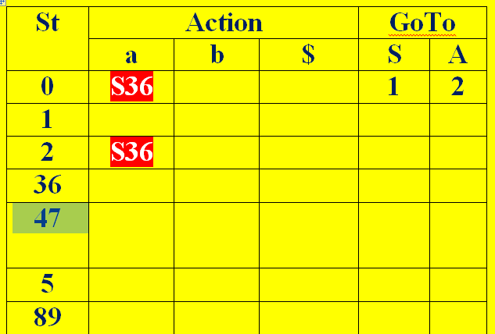
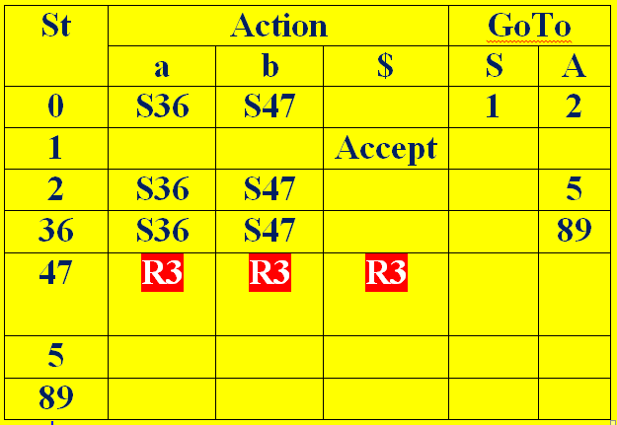
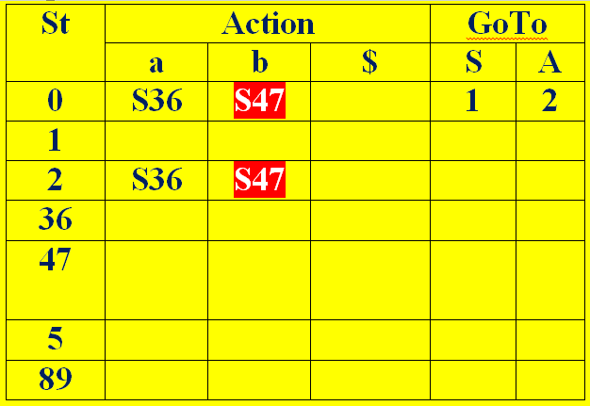
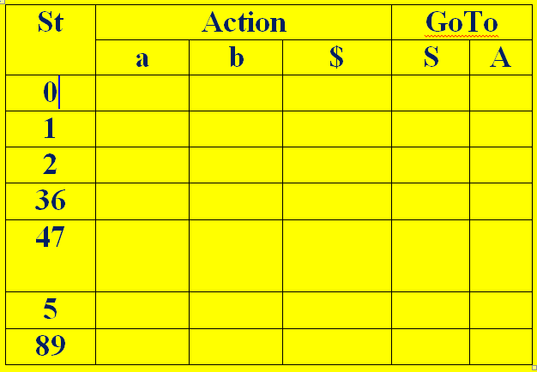

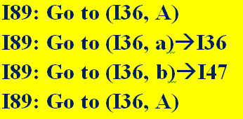
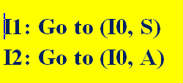



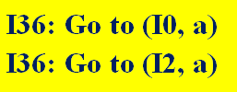

LALR PARSE Table:

Slide 31
Stack Implementation for Input string “abb”
St | Action |  |  | GoTo
 | a | b | $ | S | A
0 | S36 | S47 |  | 1 | 2
1 |  |  | Ac
2 | S36 | S47 |  |  | 5
36 | S36 | S47 |  |  | 89
47 | R3 | R3 | R3
5 |  |  | R1
89 | R2 | R2 | R2
Stack I.Buffer Action
$0 abb$ shift
$0a36 bb$ shift
$0a36b47 b$ A→b
$0a36A89 b$ A→aA
$0A2 b$ Shift
$0A2b47 $ A→b
$0A2A5 $ S→AA
$0S1 $ Accept

Slide 32
